Slide 1



Figure 1
Metamonada
Opisthokonta
Amoebozoa
Discoba
Rhizaria
Streptophyta
Alveolata
Stramenopila
Rhodophyta
Chlorophyta

Slide 2

Figure 1

Slide 3







Figure 2

Slide 4










Figure 3
1
1694
RICTORN
RICTORM
RasGEF
Domain5
RICTOR Phosphorylation
ARM Repeats
1
1353
RAPTORN
ARM Repeats
HEAT
ARM Repeats
WD-40 Repeats

Slide 5
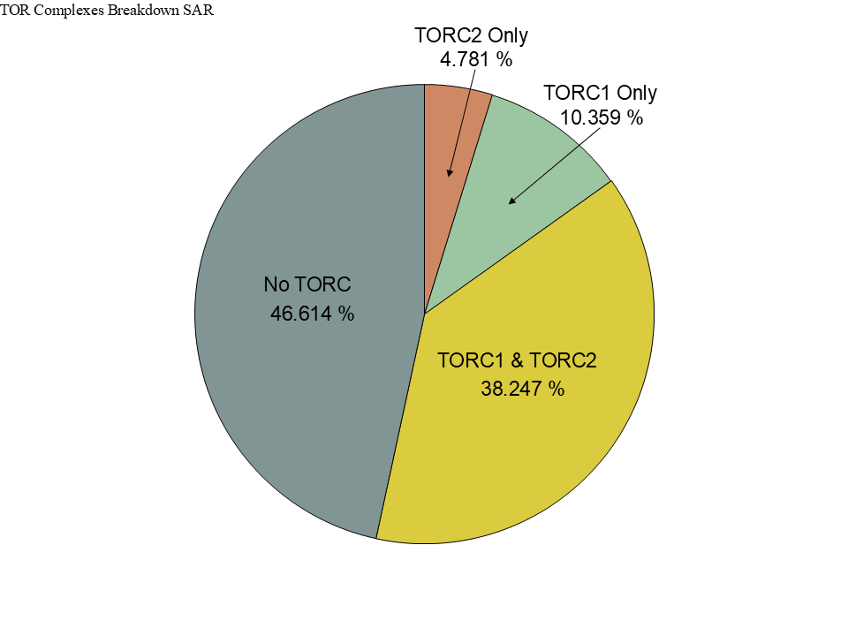
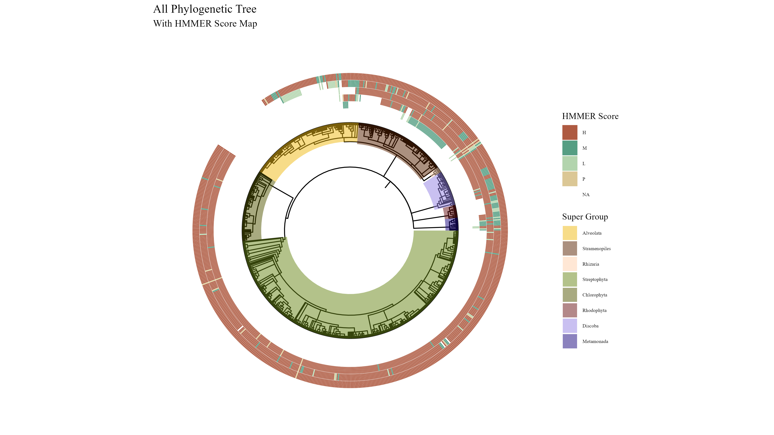
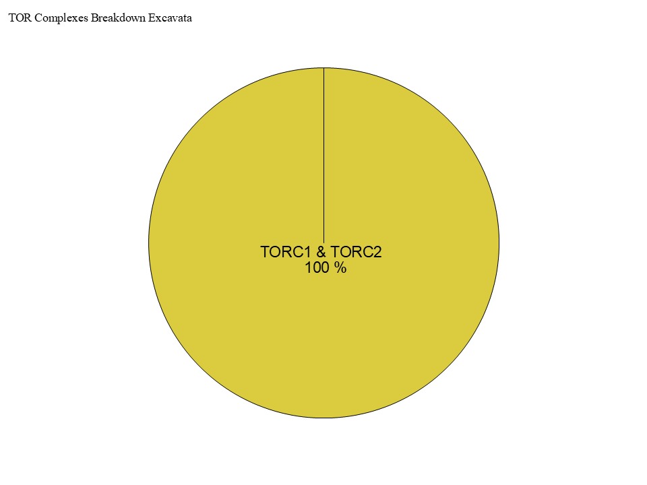
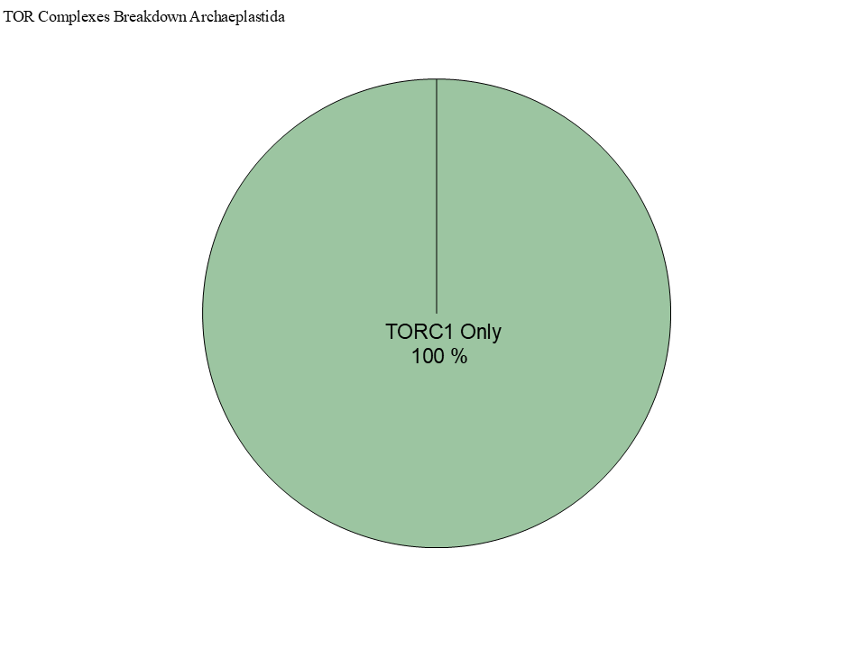
Figure 4

Slide 6
Figure 4

Slide 7



Figure 4

Slide 8


Slide 9



Slide 10
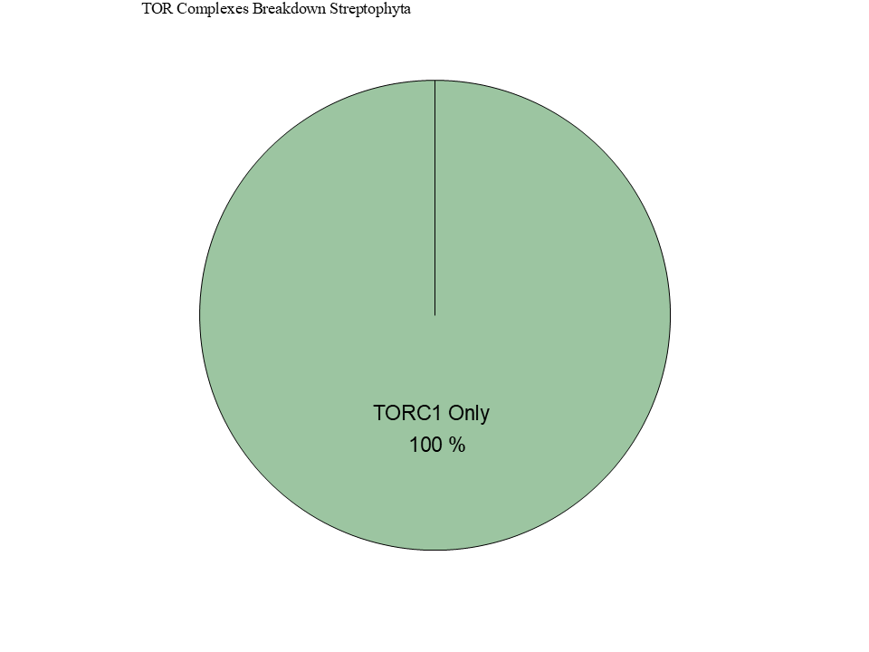
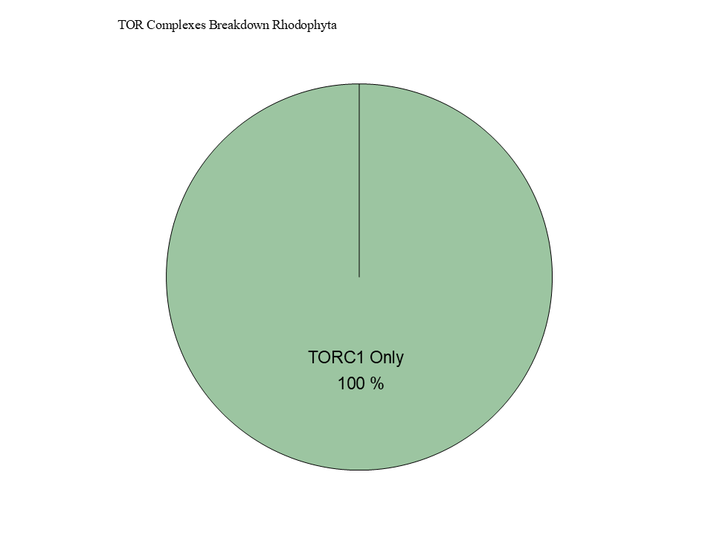

Slide 11





Figure 6

Slide 12
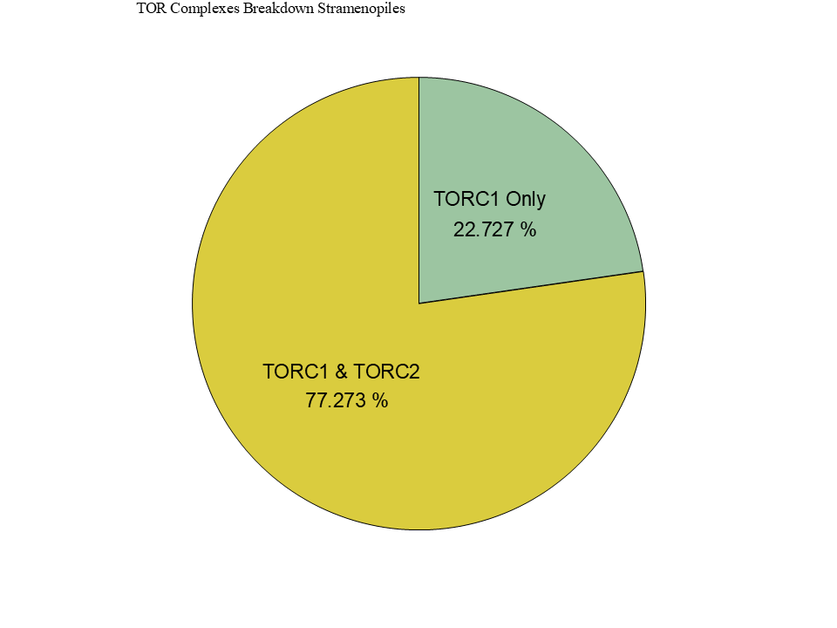
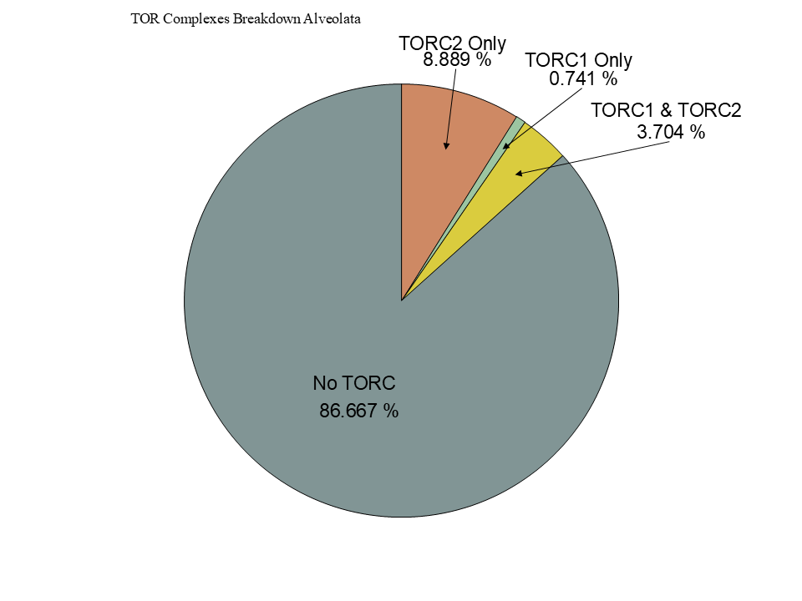
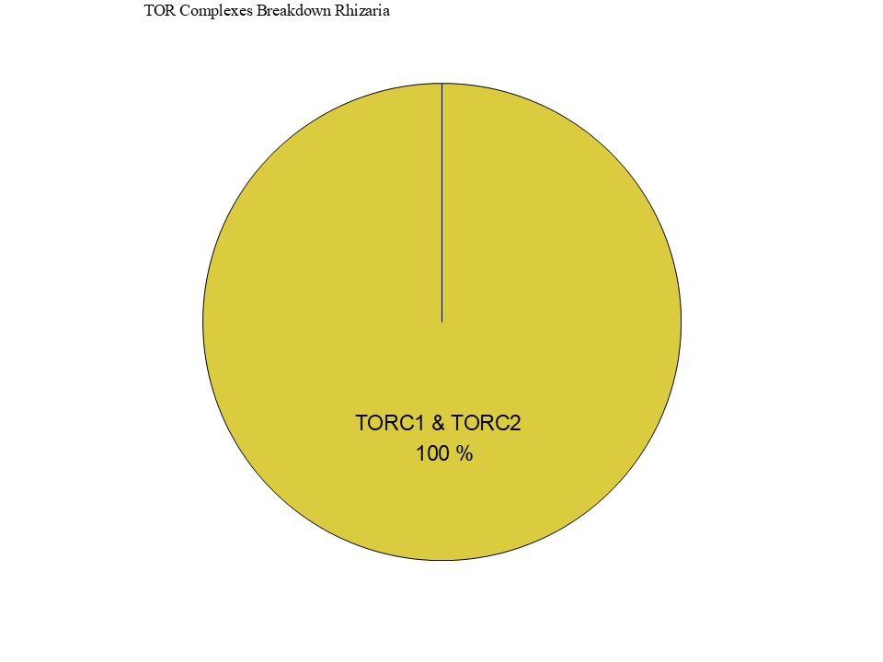
Figure 6

Slide 13
Figure 5

Slide 14
Figure 5

Slide 15


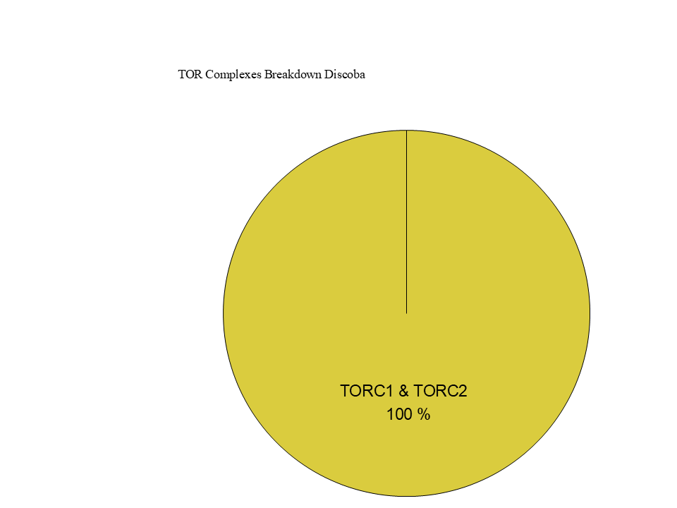
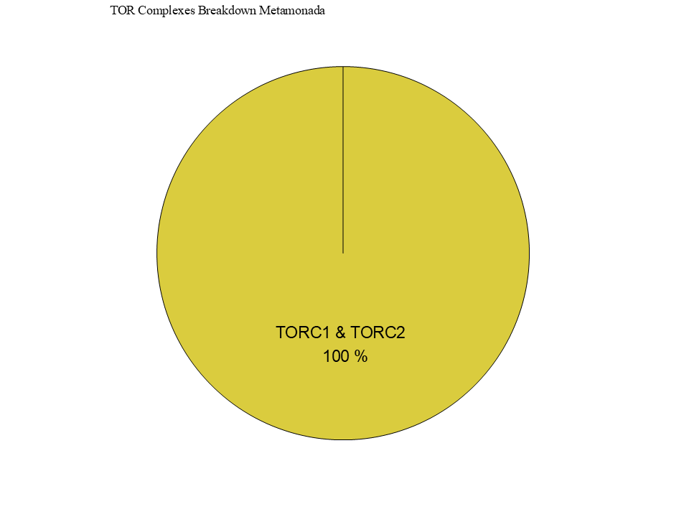
Figure 7

Slide 16
Workflow/Pipeline
NCBI/JGI Genomic Information
MSA
Phylogenetic Tree(s)
Results/TOR Complex Patterns
BUSCO/HMMER/BLAST
R Tables & Taxonomy Tables
Graphs/Data Table
SRA /Diamond Alignment
Notes:
We need to add a start point. Have something that asks the question; what organisms have TORC2 Components and TORC1 Components?

Slide 17
SARs Gain of Plastids:
Losses of TOR Complexes
Rhodophyta Endosymbiosis
Phaeodactylum tricornutum
TORC2 Lost
Macrocystis pyrifera
Stramenopila
Nannochloropsis gaditana
Phytophthora sojae
Expected Heterotrophic Ancestor
TORC1 & TORC2 Present
Stramenopile Endosymbiosis
Polarella glaciallis
Vitrella Brassicaformis
Alveolata
Plasmodium falciparum
Tetrahymena thermophila
Alpha-Cyanobacteria Endosymbiosis
Photoautorophy Loss
Paulinella micropora
TORC1 and TORC2 Lost
Bigelowiella natans
TORC1 Lost
Rhizaria
Chlorophyta Endosymbiosis
Plasmodiophora brassicae

Slide 18
Simplified Excavata Gain of Plastids
Chlorophyta Endosymbiosis
Euglenophyceae
Discoba
Kinetoplastea
Eutetramitia, etc.
Expected Heterotrophic Ancestor
TORC1 & TORC2 Present
Metamonada

